Slide 1
Little Languages

Slide 2
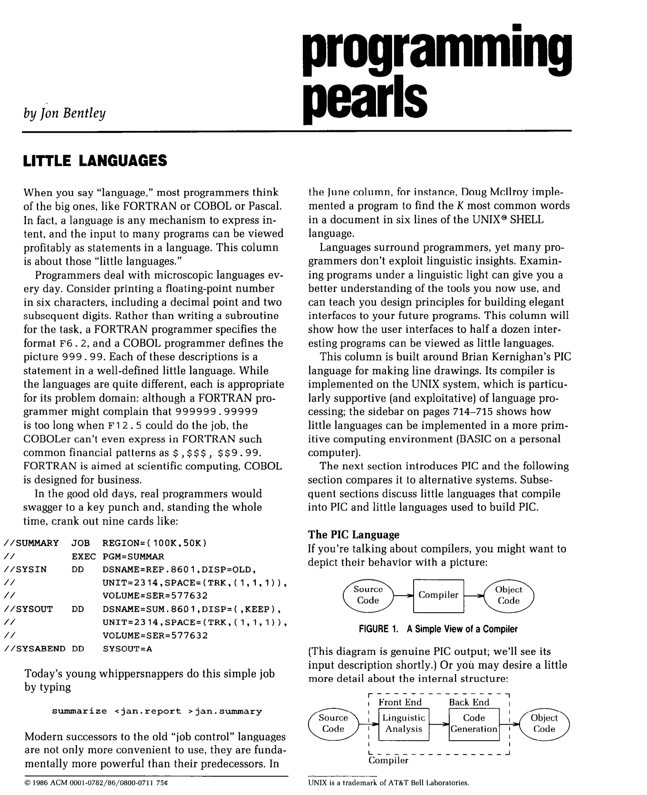
Little Languages (from Unix)
Bentley (CACM-1986)

Slide 3
We propose gft, a Little Language
In the good old days,
real programmers would copy a few hundred lines of
PyTorch from HuggingFace
and modify as necessary to change
models,
datasets,
task,
etc.
With gft, 100s of lines → 1-line
More accessible to masses
(including non-programmers)

Slide 4
Standard 3-Step Recipe
Step | Description | Time | Hardware
1
2
3 | Inference (predict) | Seconds/Minutes | 0+ GPUs
Easy

Slide 5
Standard 3-Step Recipe
Most users should not do this themselves
Step | Description | Time | Hardware
1 | Pre-Training | Days/Weeks | Large GPU cluster
2
3 | Inference (predict) | Seconds/Minutes | 0+ GPUs

Slide 6
Standard 3-Step Recipe
Step | Description | Time | Hardware
1 | Pre-Training | Days/Weeks | Large GPU cluster
2 | Fine-Tuning (fit) | Hours/Days | 1+ GPUs
3 | Inference (predict) | Seconds/Minutes | 0+ GPUs
Not Hard

Slide 7

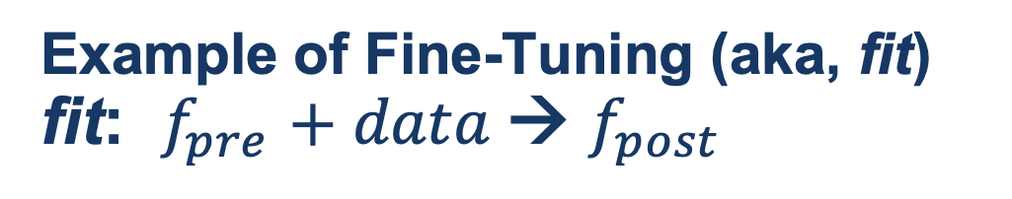
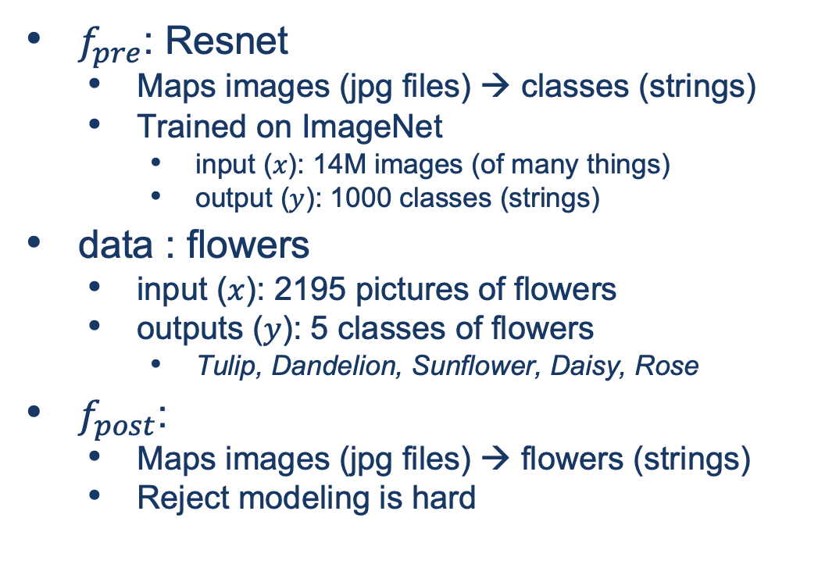
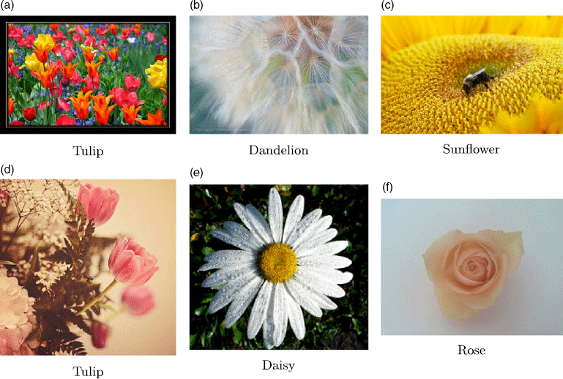
Guide Book App

Slide 8
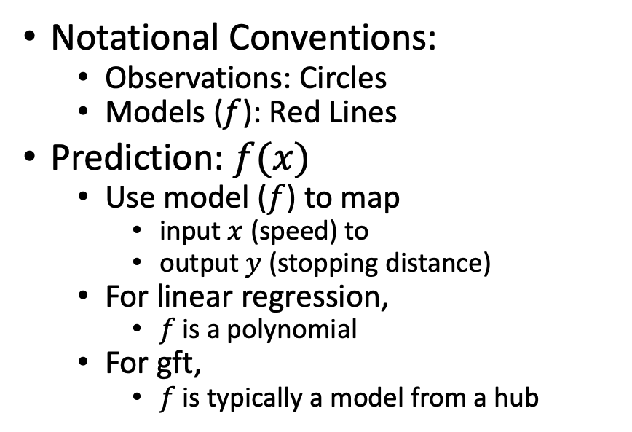
Fine-Tuning (Fit) in R (Statistics Package)
Make deep nets look like regression
(Not much programming)
Black Points:
cars dataset
Notational Conventions:
Observations: Circles
Models ($f$): Red Lines
Prediction: $f(x)$
Use model ($f$) to map
input $x$ (speed) to
output $y$ (stopping distance)
For linear regression,
$f$is a polynomial
For gft,
$f$is typically a model from a hub
Red Line:
Model (f)

Slide 9
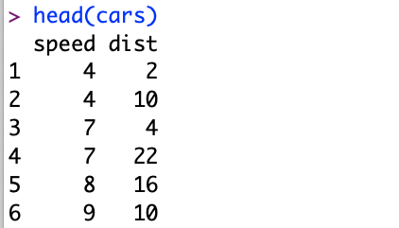
Datasets Example: Cars
Two Columns:
cars$speed
cars$dist

Slide 10
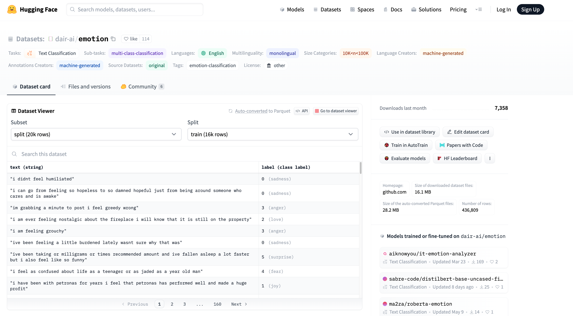


Example of Datasets in HuggingFace https://huggingface.co/datasets/dair-ai/emotion
$$x$$
$$y$$

Slide 11
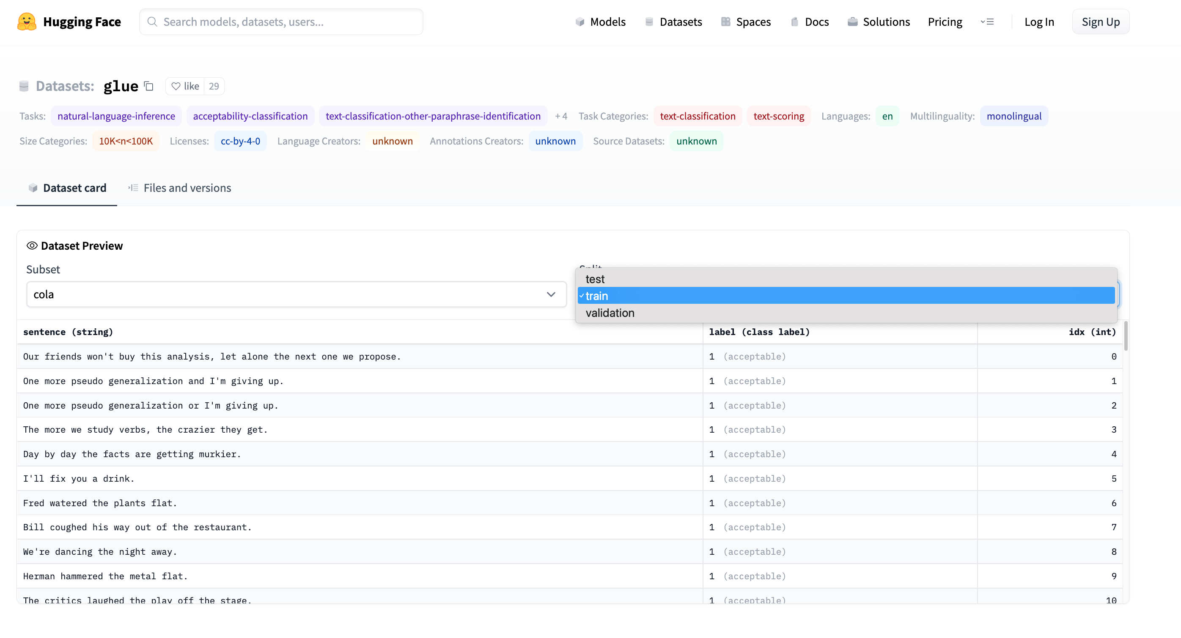
Emotion → GLUE (Cola) https://huggingface.co/datasets/glue/viewer/cola/train
Terminology: Splits
Terminology: Subset

Slide 12
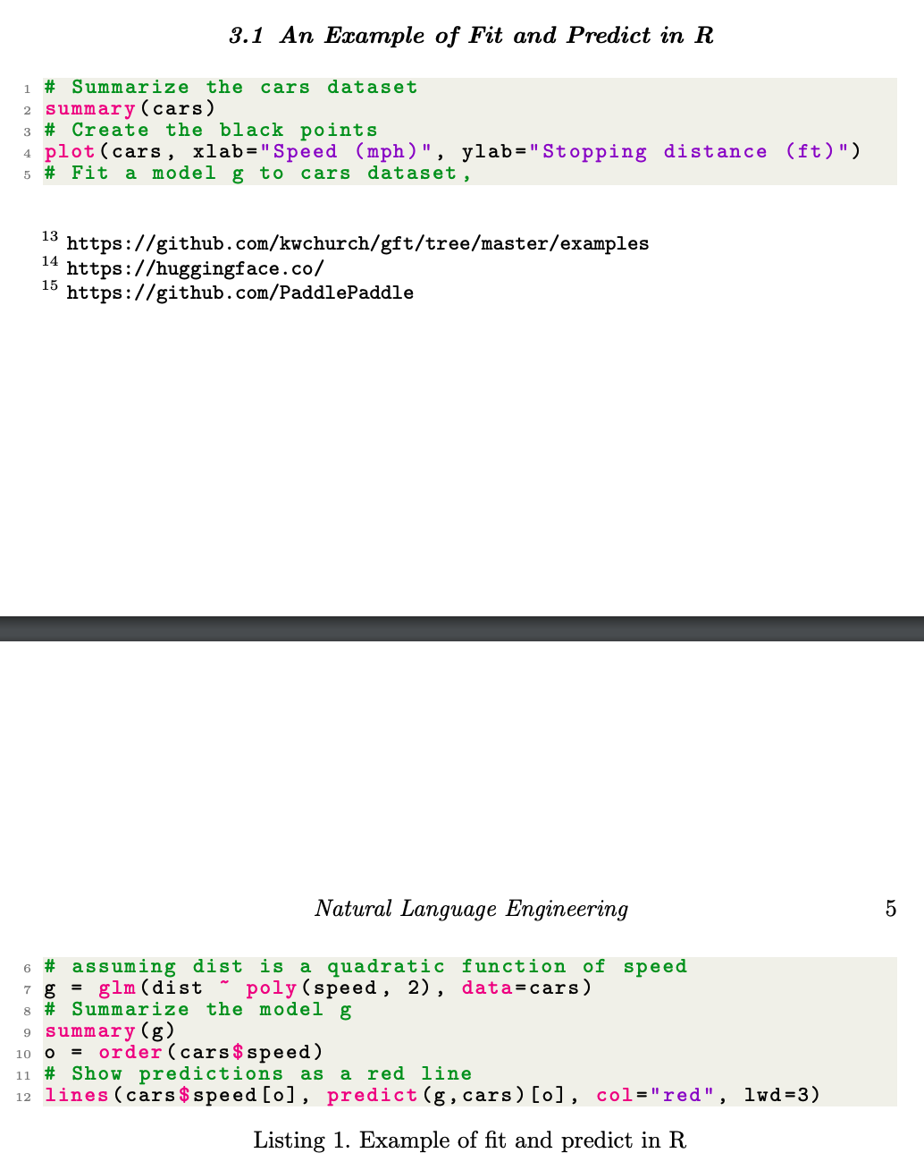
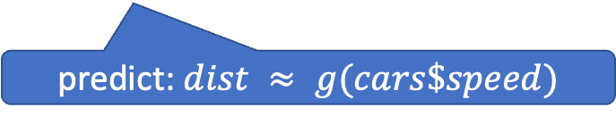
glm (General Linear Models) in R (and Sklearn)
glm: fit poly model with data
predict: $dist ≈ g(cars\$speed)$

Slide 13
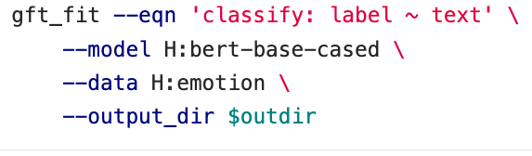
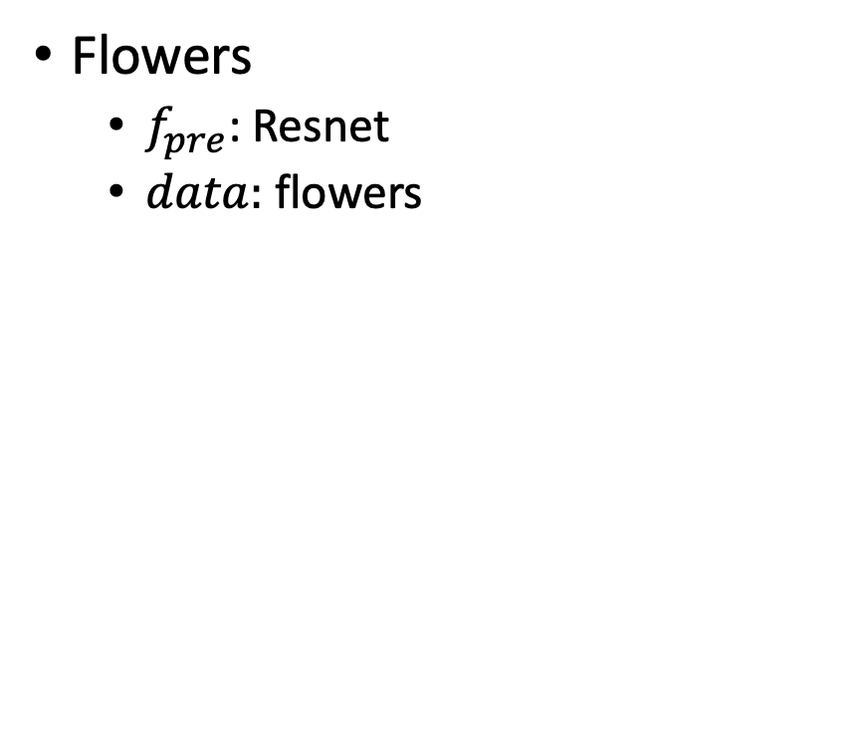
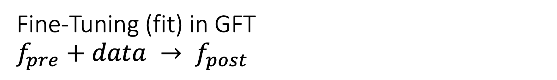
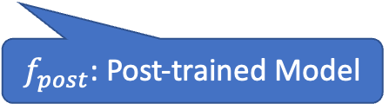
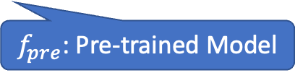
Fine-Tuning (fit) in GFT $f_{pre}+data → f_{post}$
Flowers
$f_{pre}$: Resnet
$data:$flowers
$f_{pre}$: Pre-trained Model
$f_{post}$: Post-trained Model
Fine-Tuning (fit) in R

Slide 14
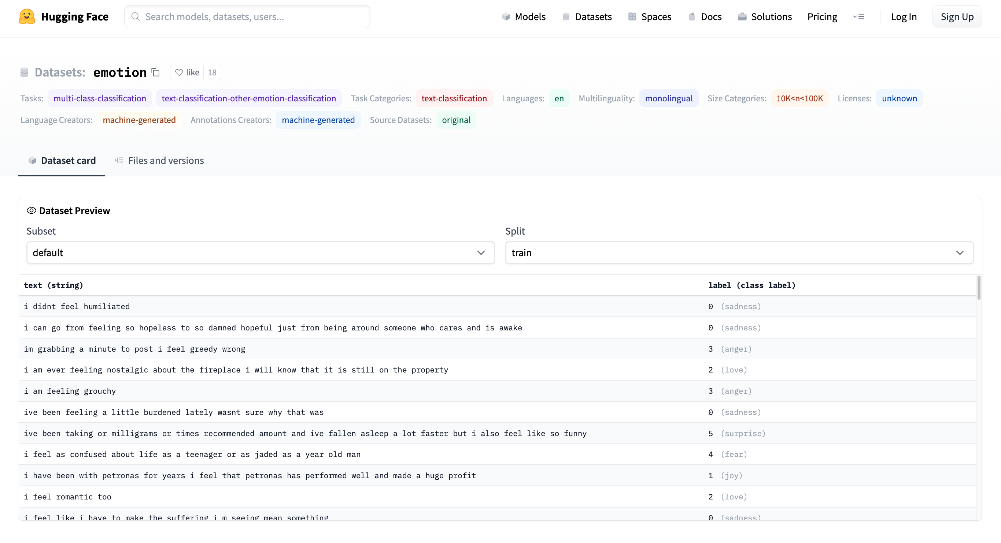
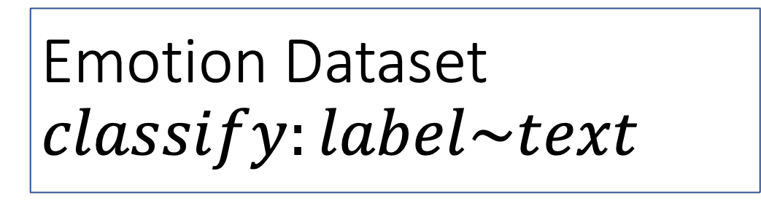
Emotion Dataset $$classify:label\sim text$$
Task/Loss
Columns
Columns
Row

Slide 15
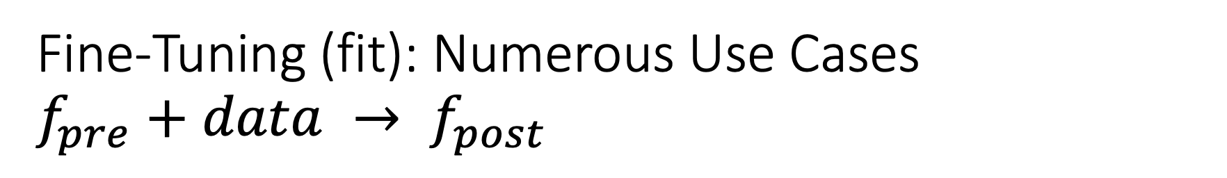
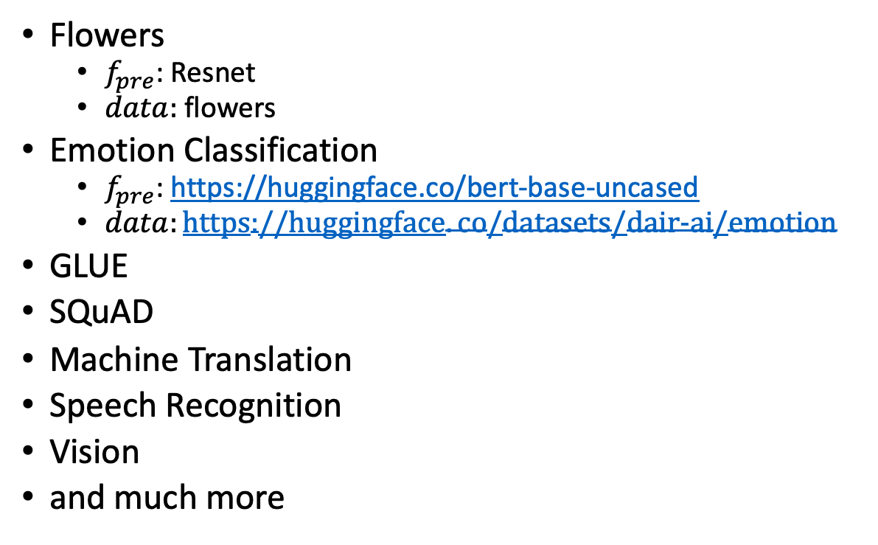
Fine-Tuning (fit): Numerous Use Cases $f_{pre}+data → f_{post}$
Flowers
$f_{pre}$: Resnet
$data:$flowers
Emotion Classification
$f_{pre}$: https://huggingface.co/bert-base-uncased
$data:https://huggingface.co/datasets/dair−ai/emotion$
GLUE
SQuAD
Machine Translation
Speech Recognition
Vision
and much more
$f_{pre}$: Pre-trained Model
$f_{post}$: Post-trained Model
Fine-Tuning (fit) in R

Slide 16
GLUE Subsets
GLUE COLA SUBSET
Sentence | Label
Bill sang himself to sleep. | 1 (acceptable)
Bill squeezed the puppet through the hole. | 1 (acceptable)
Bill sang Sue to sleep. | 1 (acceptable)
The elevator rumbled itself to the ground. | 0 (unacceptable)
If the telephone rang, it could ring itself silly. | 1 (acceptable)
She yelled hoarse. | 0 (unacceptable)
Ted cried to sleep. | 0 (unacceptable)
The tiger bled to death. | 1 (acceptable)
Subset | Dataset
COLA | H:glue,cola
SST2 | H:glue,sst2
WNLI | H:glue,wnli
MRPC | H:glue,mrpc
QNLI | H:glue,qnli
QQP | H:glue,qqp
SSTB | H:glue,sstb
MNLI | H:glue,mnli

Slide 17
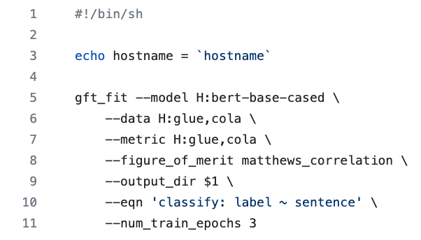
GFT Program for COLA
GLUE COLA SUBSET
Sentence | Label
Bill sang himself to sleep. | 1 (acceptable)
Bill squeezed the puppet through the hole. | 1 (acceptable)
Bill sang Sue to sleep. | 1 (acceptable)
The elevator rumbled itself to the ground. | 0 (unacceptable)
If the telephone rang, it could ring itself silly. | 1 (acceptable)
She yelled hoarse. | 0 (unacceptable)
Ted cried to sleep. | 0 (unacceptable)
The tiger bled to death. | 1 (acceptable)
https://github.com/kwchurch/gft/blob/master/examples/fit_examples/model.HuggingFace/language/data.HuggingFace/glue/cola.sh

Slide 18
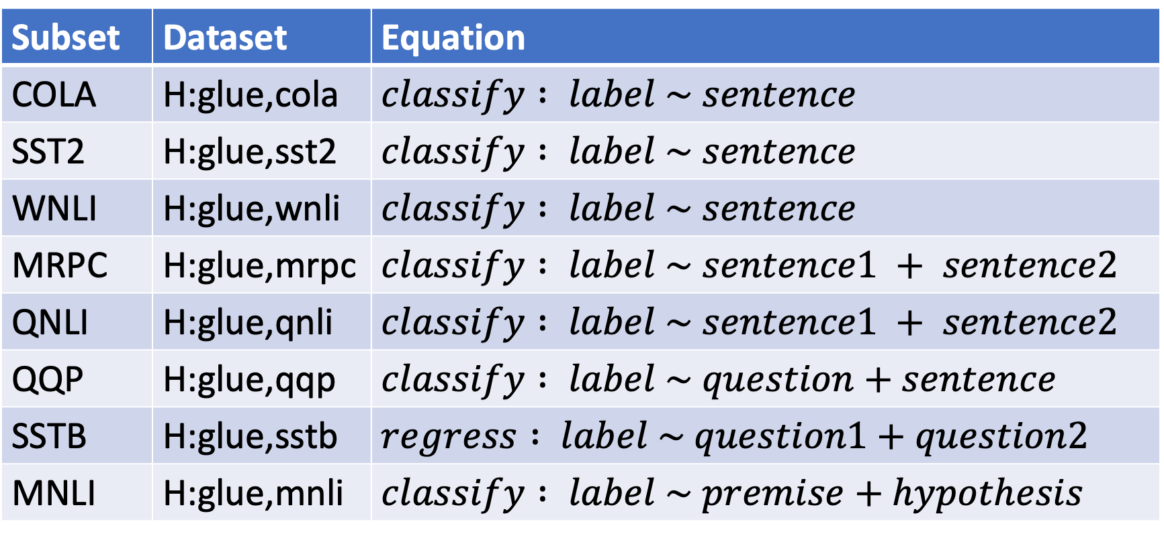
Simple Equations Cover Many Cases of Interest GLUE: A Popular Benchmark
Subset | Dataset | Equation
COLA | H:glue,cola | $$classify : label \sim sentence$$
SST2 | H:glue,sst2 | $$classify : label \sim sentence$$
WNLI | H:glue,wnli | $$classify : label \sim sentence$$
MRPC | H:glue,mrpc | $$classify : label \sim sentence1 + sentence2$$
QNLI | H:glue,qnli | $$classify : label \sim sentence1 + sentence2$$
QQP | H:glue,qqp | $$classify : label \sim question+sentence$$
SSTB | H:glue,sstb | $$regress : label \sim question1+question2$$
MNLI | H:glue,mnli | $$classify : label \sim premise+hypothesis$$

Slide 19
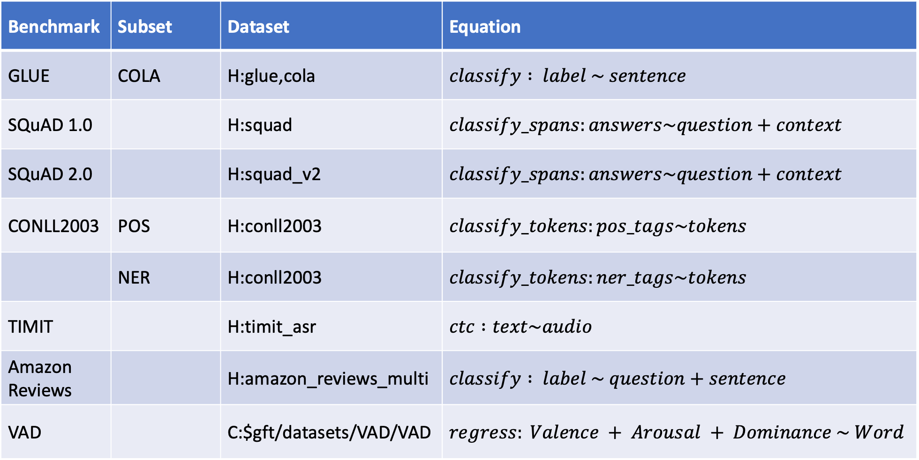
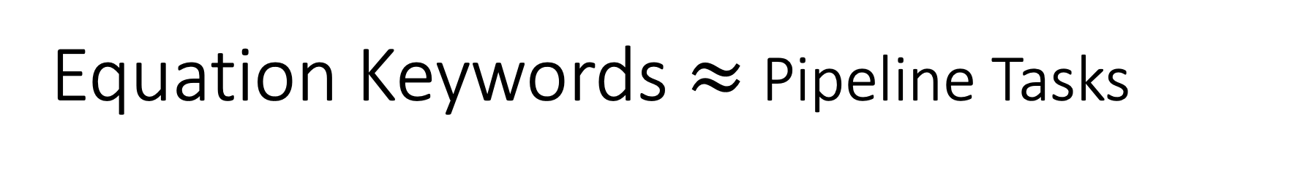
Equation Keywords $≈$ Pipeline Tasks
Benchmark | Subset | Dataset | Equation
GLUE | COLA | H:glue,cola | $$classify : label \sim sentence$$
SQuAD 1.0 |  | H:squad | $$classify_spans:answers\sim question+context$$
SQuAD 2.0 |  | H:squad_v2 | $$classify_spans:answers\sim question+context$$
CONLL2003 | POS | H:conll2003 | $$classify_tokens:pos_tags\sim tokens$$
 | NER | H:conll2003 | $$classify_tokens:ner_tags\sim tokens$$
TIMIT |  | H:timit_asr | $$ctc :text\sim audio$$
Amazon Reviews |  | H:amazon_reviews_multi | $$classify : label \sim question+sentence$$
VAD |  | C:$gft/datasets/VAD/VAD | $$regress: Valence + Arousal + Dominance \sim Word$$

Slide 20
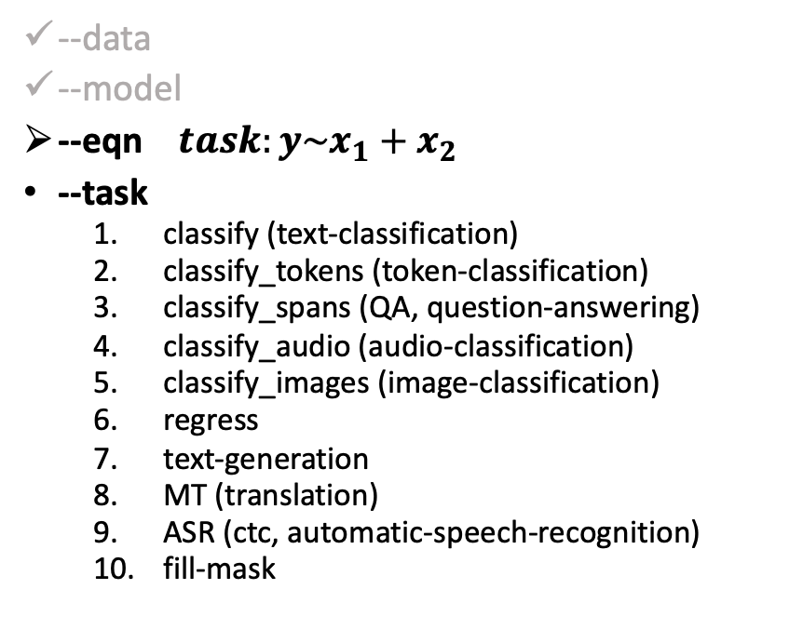
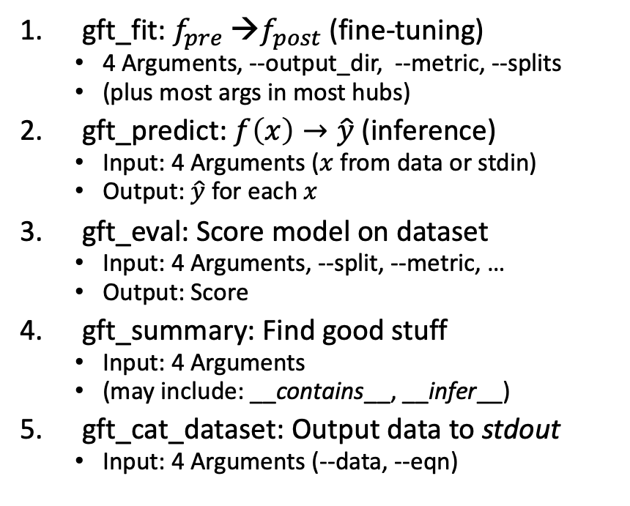
gft Cheat Sheet (General Fine-Tuning)
4+1 Functions
4 Arguments
gft_fit: $f_{pre}$ →$f_{post}$(fine-tuning)
4 Arguments, --output_dir, --metric, --splits
(plus most args in most hubs)
gft_predict: $f\left(x\right)→\hat{y}$ (inference)
Input: 4 Arguments ($x$ from data or stdin)
Output: $\hat{y}$ for each $x$
gft_eval: Score model on dataset
Input: 4 Arguments, --split, --metric, …
Output: Score
gft_summary: Find good stuff
Input: 4 Arguments
(may include: __contains__, __infer__)
gft_cat_dataset: Output data to stdout
Input: 4 Arguments (--data, --eqn)
--data
--model
--eqn $task:y\sim x_{1}+x_{2}$
--task
classify (text-classification)
classify_tokens (token-classification)
classify_spans (QA, question-answering)
classify_audio (audio-classification)
classify_images (image-classification)
regress
text-generation
MT (translation)
ASR (ctc, automatic-speech-recognition)
fill-mask

Slide 21
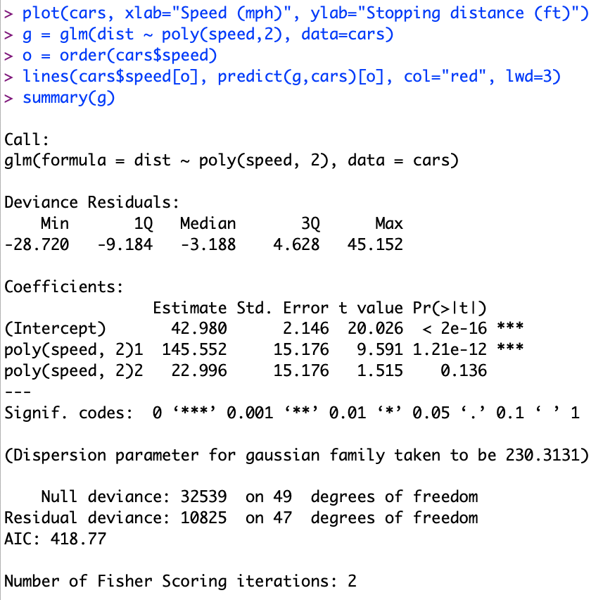
Regression in R: Summarize (almost) anything
Fit a model (g) to data (cars)

Slide 22
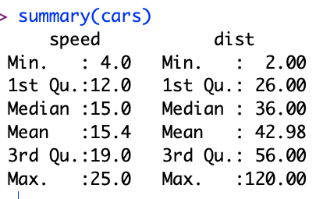
Regression in R: Summarize (almost) anything

Slide 23
Regression in R: Summarize (almost) anything
Fit a model (g) to data (cars)
Predict
Summarize a model (g)
Opportunity to Improve g

Slide 24

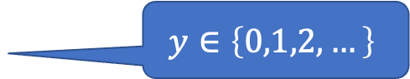

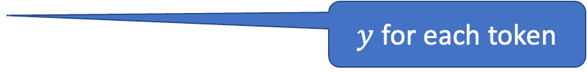
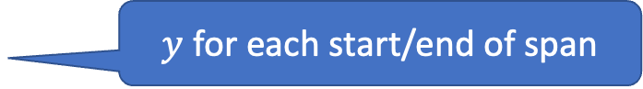
Tasks
$$y∈\left\{0,1,2,…\right\}$$
classify, text-classification
regress
QA, Question Answering, classify spans
token classification
NER (Named Entity Recognition)
POS (Part of Speech Tagging)
translation, MT
ASR, Automatic Speech Recognition, ctc
$y∈ℝ$ or $y∈ℝ^{N}$
$y$ for each start/end of span
$y$ for each token
$y$ for each phoneme

Slide 25
gft Design Goals
Inclusiveness:
Accessible to Masses
(including non-programmers)
Portability
Ease-of-Use/Transparency >> SOTA
Hide Complexity/Magic (Alchemy)
No one would suggest
Regression-like methods are ``intelligent’’

Slide 26
Portability: Inclusiveness + Hedge
gft Programs
H → HuggingFace
gft_fit --model H:bert-base-cased \
--data H:emotion \
--output_dir $1 \
--eqn 'classify: label ~ text'
Hedge
(Supply Chains)
Hedge
(Supply Chains)
P → PaddleNLP
gft_fit --model P:ernie-tiny \
--data P:chnsenticorp \
--output_dir $1 \
--eqn 'classify: label ~ text'
Emphasis on Chinese

Slide 27
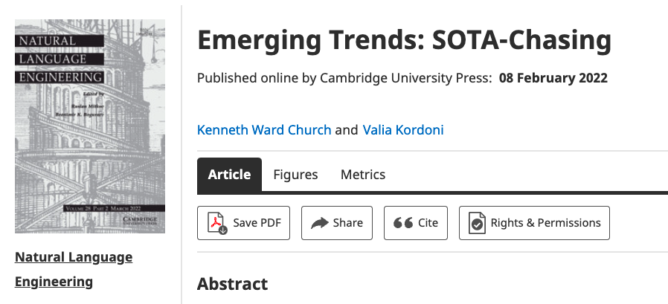
Strategy: Inclusiveness
Get your priorities right: Inclusiveness >> Exclusiveness
SOTA-Chasing 👎 (Exclusive: mine is bigger than yours)
Crossing the Chasm 👍 (Inclusive: Appeal to mainstream users)
Hubs: Get big quick 👍 (Inclusive: Usage >> SOTA)

Slide 28
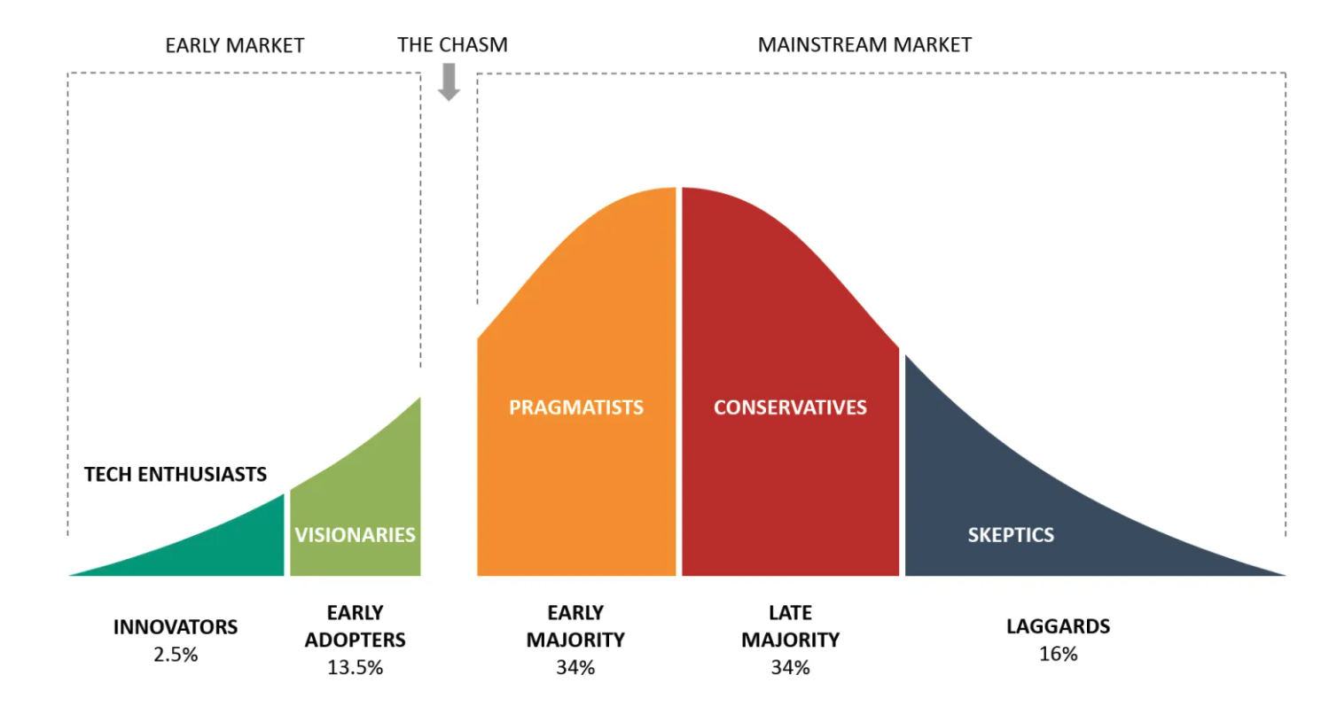
Bigger Opportunities:
(l)users (aka poets)
Engineers

Slide 29
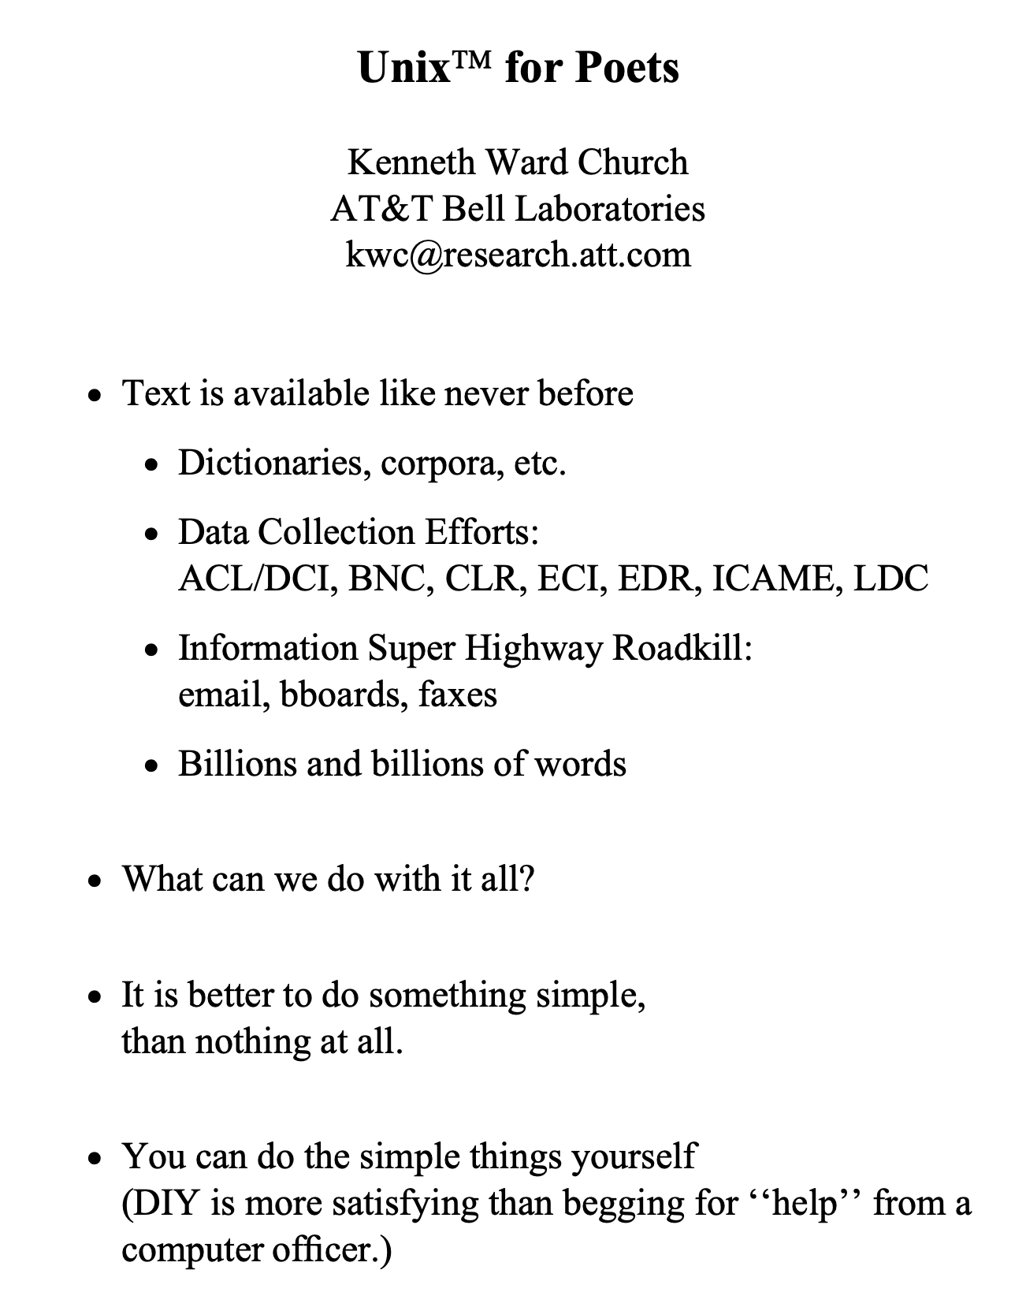
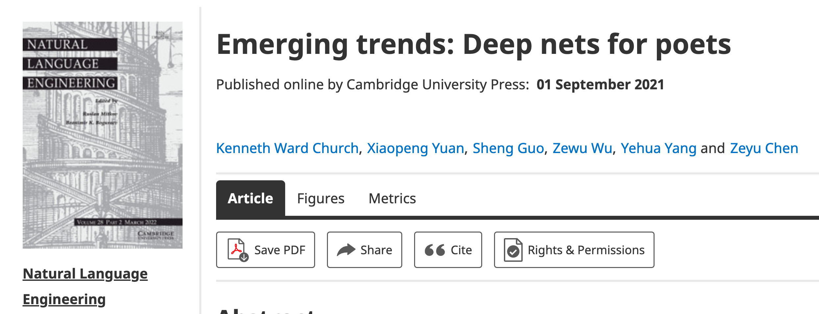
Poets
Poets is an imperfect metaphor,
intended as a gesture toward inclusion.
The future for deep nets
will benefit by reaching out to
a broad audience of potential users,
including people with
little or no programming skills,
and little interest in training models.
Lessons from success of Unix
Less is more
Inclusion: Appeal to power users as well as masses
Portability: Inclusiveness++

Slide 30
Hub Strategy: Usage >> SOTA
(Sensible) Priority for Startups
(Mistaken) Priority Research
Startup Strategy:
Get big quick
SOTA is like sprinting (hard work)
Avoid temptation to sprint to front
(except when it is worth the effort)
Hubs spend most of the race
in the peloton drafting researchers
Make it easy for 3rd parties
to post their best models on your hub
Use of 3rd parties → Wide range in quality
Best are amazing: best in class, industrial strength…
But some don’t work well, and may not even load…
Help users find good stuff & embrace community

Slide 31
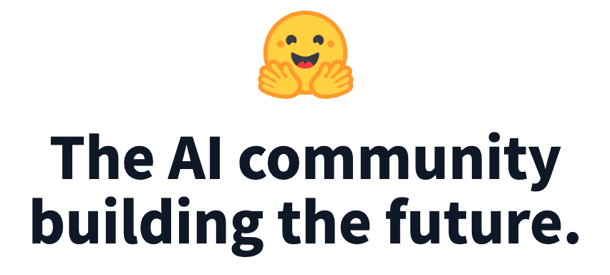
Lots of Models on Hubs (for lots of tasks)
Natural Language
Classification
Sentiment: positive/negative, 1-5 stars
Emotion classification
Hate speech classification
Guess missing word (fill-mask; cloze task)
Part of speech tagging
NER (named entity recognition)
Question Answering (SQUAD)
Entailment (GLUE)
Image Classification
Speech recognition
Machine Translation
Examples of fill-mask
echo … | gft_predict --task fill-mask
I <mask> you
miss|0.295
love|0.174
salute|0.158
I love the <mask> guy
pizza|0.035
funny|0.016
old|0.010
Examples of machine translation
echo …| gft_predict --task translation \
--model H:Helsinki-NLP/opus-mt-en-fr
I love you
Je t'aime.
2k translation models
on HuggingFace

Slide 32
Fine-Tuning (fit): Numerous Use Cases $f_{pre}+data → f_{post}$
Flowers
$f_{pre}$: Resnet
$data:$flowers
Emotion Classification
$f_{pre}$: https://huggingface.co/bert-base-uncased
$data:https://huggingface.co/datasets/dair−ai/emotion$
GLUE
SQuAD
Machine Translation
Speech Recognition
Vision
and much more
$f_{pre}$: Pre-trained Model
$f_{post}$: Post-trained Model
Fine-Tuning (fit) in R

Slide 33
GLUE Subsets
GLUE COLA SUBSET
Sentence | Label
Bill sang himself to sleep. | 1 (acceptable)
Bill squeezed the puppet through the hole. | 1 (acceptable)
Bill sang Sue to sleep. | 1 (acceptable)
The elevator rumbled itself to the ground. | 0 (unacceptable)
If the telephone rang, it could ring itself silly. | 1 (acceptable)
She yelled hoarse. | 0 (unacceptable)
Ted cried to sleep. | 0 (unacceptable)
The tiger bled to death. | 1 (acceptable)
Subset | Dataset
COLA | H:glue,cola
SST2 | H:glue,sst2
WNLI | H:glue,wnli
MRPC | H:glue,mrpc
QNLI | H:glue,qnli
QQP | H:glue,qqp
SSTB | H:glue,sstb
MNLI | H:glue,mnli

Slide 34
GFT Program for COLA
GLUE COLA SUBSET
Sentence | Label
Bill sang himself to sleep. | 1 (acceptable)
Bill squeezed the puppet through the hole. | 1 (acceptable)
Bill sang Sue to sleep. | 1 (acceptable)
The elevator rumbled itself to the ground. | 0 (unacceptable)
If the telephone rang, it could ring itself silly. | 1 (acceptable)
She yelled hoarse. | 0 (unacceptable)
Ted cried to sleep. | 0 (unacceptable)
The tiger bled to death. | 1 (acceptable)
https://github.com/kwchurch/gft/blob/master/examples/fit_examples/model.HuggingFace/language/data.HuggingFace/glue/cola.sh

Slide 35
Simple Equations Cover Many Cases of Interest GLUE: A Popular Benchmark
Subset | Dataset | Equation
COLA | H:glue,cola | $$classify : label \sim sentence$$
SST2 | H:glue,sst2 | $$classify : label \sim sentence$$
WNLI | H:glue,wnli | $$classify : label \sim sentence$$
MRPC | H:glue,mrpc | $$classify : label \sim sentence1 + sentence2$$
QNLI | H:glue,qnli | $$classify : label \sim sentence1 + sentence2$$
QQP | H:glue,qqp | $$classify : label \sim question+sentence$$
SSTB | H:glue,sstb | $$regress : label \sim question1+question2$$
MNLI | H:glue,mnli | $$classify : label \sim premise+hypothesis$$

Slide 36
Equation Keywords $≈$ Pipeline Tasks
Benchmark | Subset | Dataset | Equation
GLUE | COLA | H:glue,cola | $$classify : label \sim sentence$$
SQuAD 1.0 |  | H:squad | $$classify_spans:answers\sim question+context$$
SQuAD 2.0 |  | H:squad_v2 | $$classify_spans:answers\sim question+context$$
CONLL2003 | POS | H:conll2003 | $$classify_tokens:pos_tags\sim tokens$$
 | NER | H:conll2003 | $$classify_tokens:ner_tags\sim tokens$$
TIMIT |  | H:timit_asr | $$ctc :text\sim audio$$
Amazon Reviews |  | H:amazon_reviews_multi | $$classify : label \sim question+sentence$$
VAD |  | C:$gft/datasets/VAD/VAD | $$regress: Valence + Arousal + Dominance \sim Word$$

Slide 37
gft Cheat Sheet (General Fine-Tuning)
4+1 Functions
4 Arguments
gft_fit: $f_{pre}$ →$f_{post}$(fine-tuning)
4 Arguments, --output_dir, --metric, --splits
(plus most args in most hubs)
gft_predict: $f\left(x\right)→\hat{y}$ (inference)
Input: 4 Arguments ($x$ from data or stdin)
Output: $\hat{y}$ for each $x$
gft_eval: Score model on dataset
Input: 4 Arguments, --split, --metric, …
Output: Score
gft_summary: Find good stuff
Input: 4 Arguments
(may include: __contains__, __infer__)
gft_cat_dataset: Output data to stdout
Input: 4 Arguments (--data, --eqn)
--data
--model
--eqn $task:y\sim x_{1}+x_{2}$
--task
classify (text-classification)
classify_tokens (token-classification)
classify_spans (QA, question-answering)
classify_audio (audio-classification)
classify_images (image-classification)
regress
text-generation
MT (translation)
ASR (ctc, automatic-speech-recognition)
fill-mask

Slide 38
Regression in R: Summarize (almost) anything
Fit a model (g) to data (cars)

Slide 39
Regression in R: Summarize (almost) anything

Slide 40
Regression in R: Summarize (almost) anything
Fit a model (g) to data (cars)
Predict
Summarize a model (g)
Opportunity to Improve g

Slide 41
Tasks
$$y∈\left\{0,1,2,…\right\}$$
classify, text-classification
regress
QA, Question Answering, classify spans
token classification
NER (Named Entity Recognition)
POS (Part of Speech Tagging)
translation, MT
ASR, Automatic Speech Recognition, ctc
$y∈ℝ$ or $y∈ℝ^{N}$
$y$ for each start/end of span
$y$ for each token
$y$ for each phoneme

Slide 42
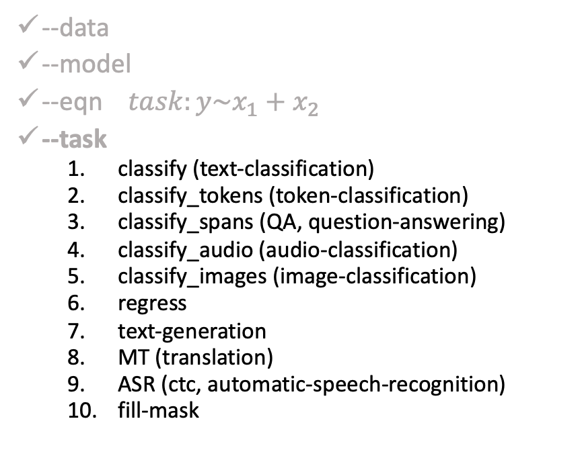
gft Cheat Sheet (General Fine-Tuning)
4+1 Functions
4 Arguments
gft_fit: $f_{pre}$ →$f_{post}$(fine-tuning)
4 Arguments, --output_dir, --metric, --splits
(plus most args in most hubs)
gft_predict: $f\left(x\right)→\hat{y}$ (inference)
Input: 4 Arguments ($x$ from data or stdin)
Output: $\hat{y}$ for each $x$
gft_eval: Score model on dataset
Input: 4 Arguments, --split, --metric, …
Output: Score
gft_summary: Find good stuff
Input: 4 Arguments
(may include: __contains__, __infer__)
gft_cat_dataset: Output data to stdout
Input: 4 Arguments (--data, --eqn)
--data
--model
--eqn $task:y\sim x_{1}+x_{2}$
--task
classify (text-classification)
classify_tokens (token-classification)
classify_spans (QA, question-answering)
classify_audio (audio-classification)
classify_images (image-classification)
regress
text-generation
MT (translation)
ASR (ctc, automatic-speech-recognition)
fill-mask

Slide 43
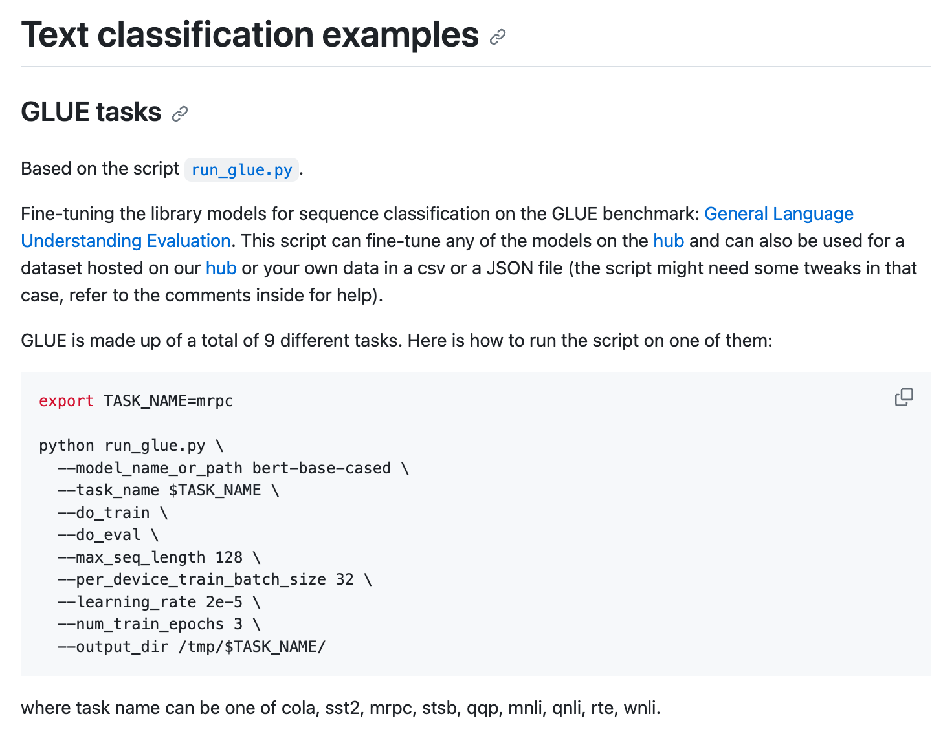
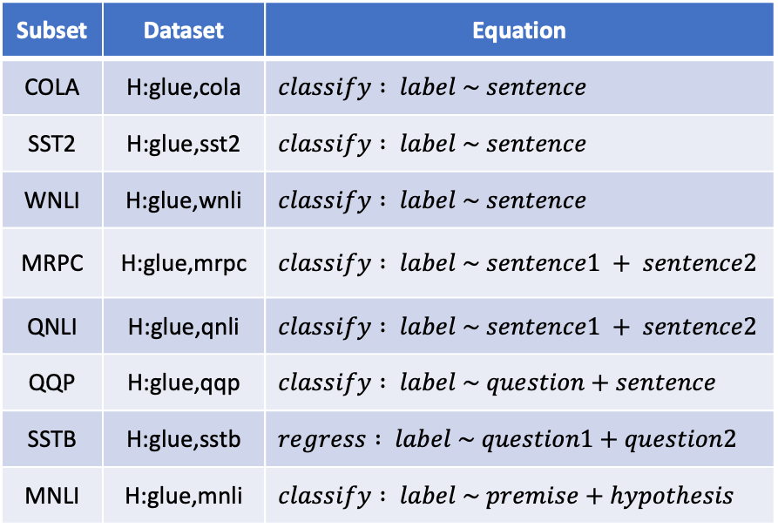
HuggingFace run_glue.py colab
GFT
https://github.com/huggingface/transformers/blob/main/examples/pytorch/text-classification/README.md
Subset | Dataset | Equation
COLA | H:glue,cola | $$classify : label \sim sentence$$
SST2 | H:glue,sst2 | $$classify : label \sim sentence$$
WNLI | H:glue,wnli | $$classify : label \sim sentence$$
MRPC | H:glue,mrpc | $$classify : label \sim sentence1 + sentence2$$
QNLI | H:glue,qnli | $$classify : label \sim sentence1 + sentence2$$
QQP | H:glue,qqp | $$classify : label \sim question+sentence$$
SSTB | H:glue,sstb | $$regress : label \sim question1+question2$$
MNLI | H:glue,mnli | $$classify : label \sim premise+hypothesis$$

Slide 44
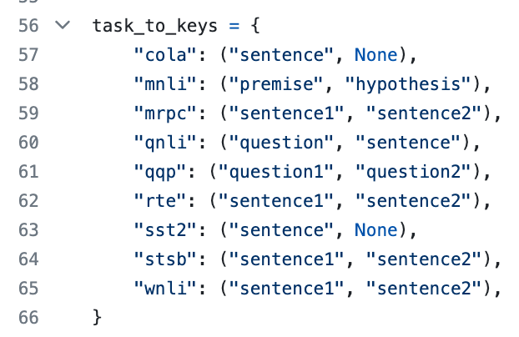
HuggingFace run_glue.py colab
GFT
https://github.com/huggingface/transformers/blob/main/examples/pytorch/text-classification/README.md
Subset | Dataset | Equation
COLA | H:glue,cola | $$classify : label \sim sentence$$
SST2 | H:glue,sst2 | $$classify : label \sim sentence$$
WNLI | H:glue,wnli | $$classify : label \sim sentence$$
MRPC | H:glue,mrpc | $$classify : label \sim sentence1 + sentence2$$
QNLI | H:glue,qnli | $$classify : label \sim sentence1 + sentence2$$
QQP | H:glue,qqp | $$classify : label \sim question+sentence$$
SSTB | H:glue,sstb | $$regress : label \sim question1+question2$$
MNLI | H:glue,mnli | $$classify : label \sim premise+hypothesis$$

Slide 45
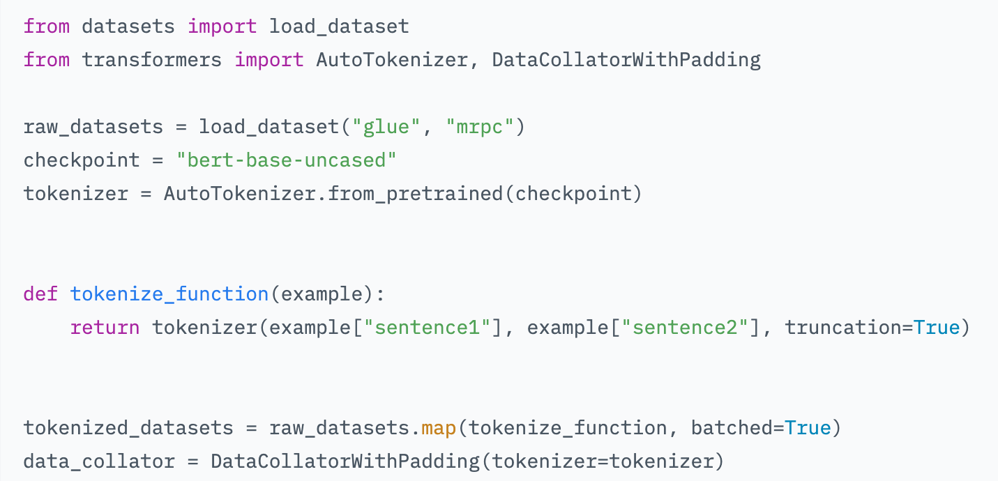
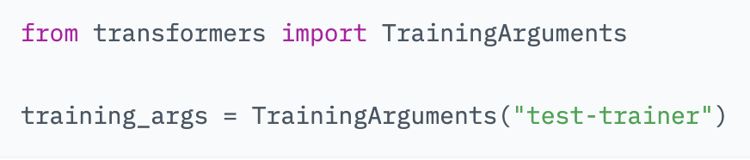
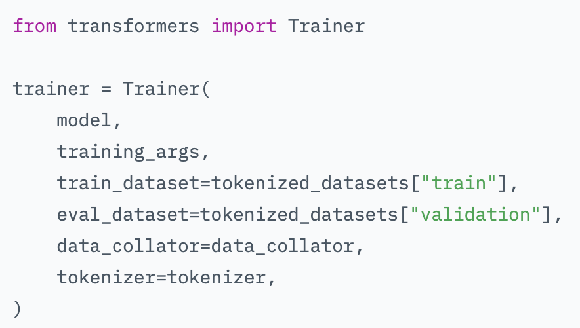
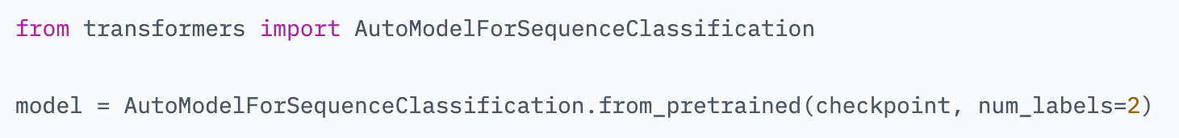
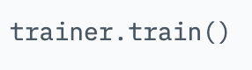
Trainer https://huggingface.co/learn/nlp-course/chapter3/3?fw=pt

Slide 46
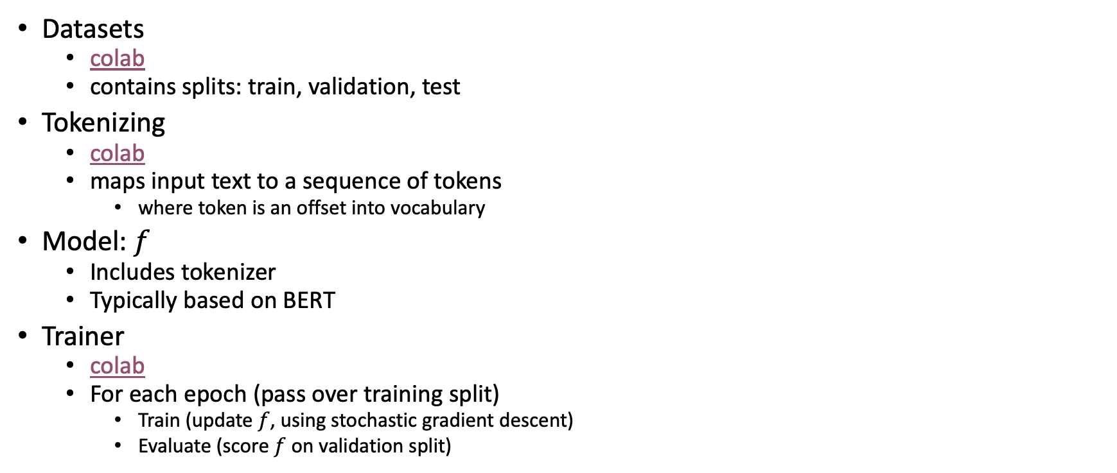
Steps
Datasets
colab
contains splits: train, validation, test
Tokenizing
colab
maps input text to a sequence of tokens
where token is an offset into vocabulary
Model: $f$
Includes tokenizer
Typically based on BERT
Trainer
colab
For each epoch (pass over training split)
Train (update $f$, using stochastic gradient descent)
Evaluate (score $f$ on validation split)

Slide 47
Trainer https://huggingface.co/learn/nlp-course/chapter3/3?fw=pt

Slide 48
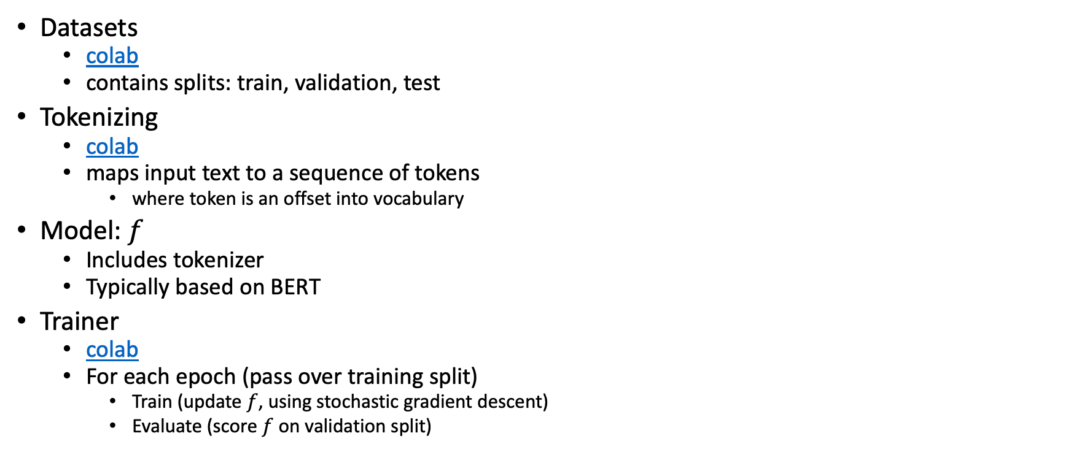
Steps (Review, again)
Datasets
colab
contains splits: train, validation, test
Tokenizing
colab
maps input text to a sequence of tokens
where token is an offset into vocabulary
Model: $f$
Includes tokenizer
Typically based on BERT
Trainer
colab
For each epoch (pass over training split)
Train (update $f$, using stochastic gradient descent)
Evaluate (score $f$ on validation split)

Slide 49
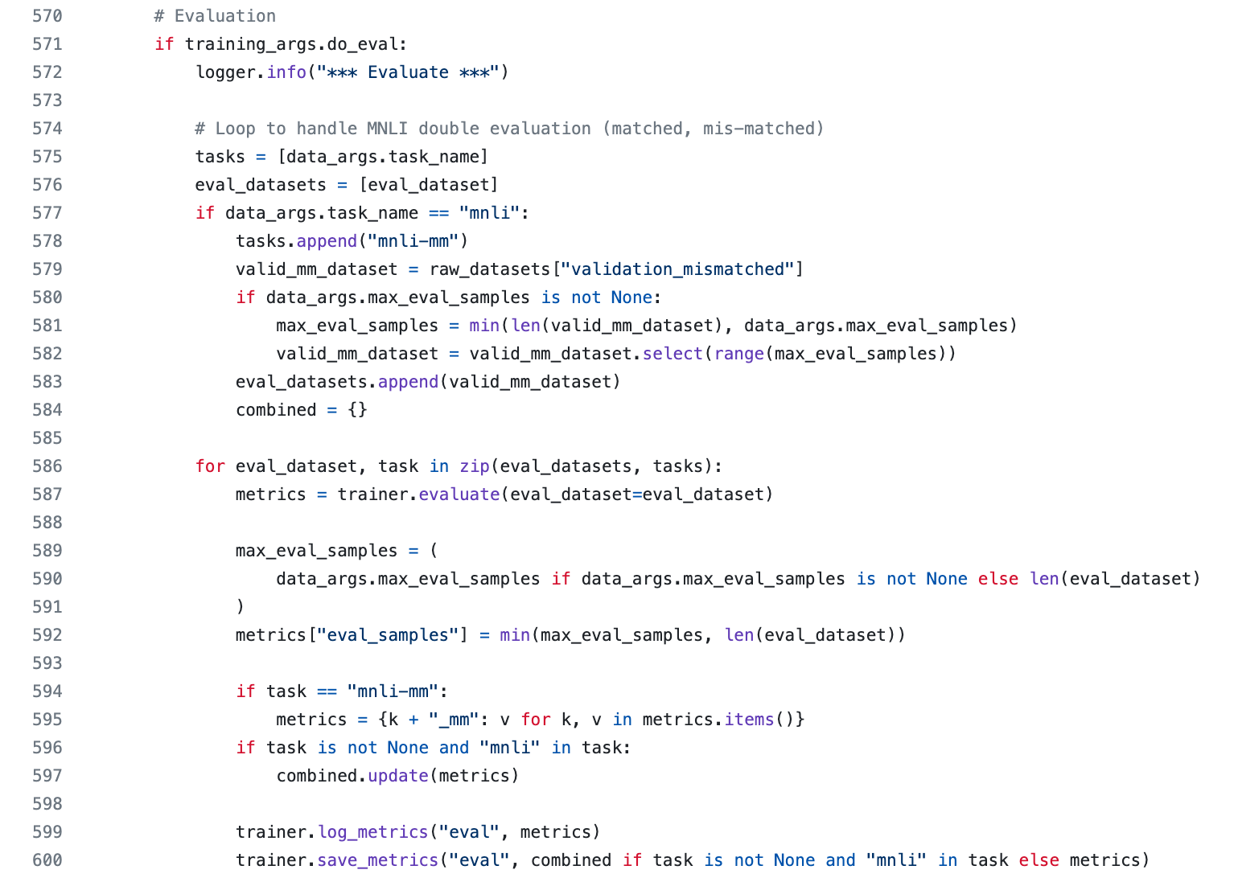
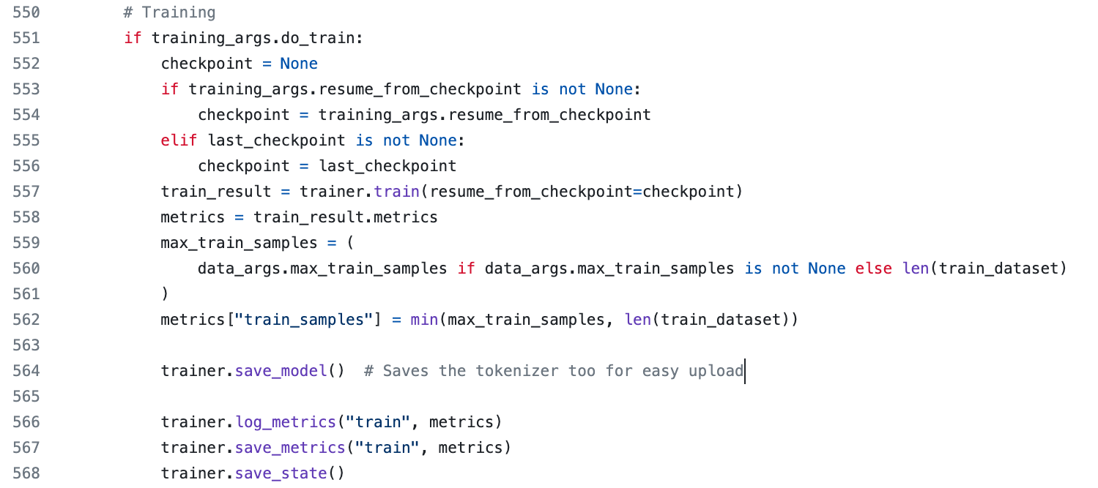
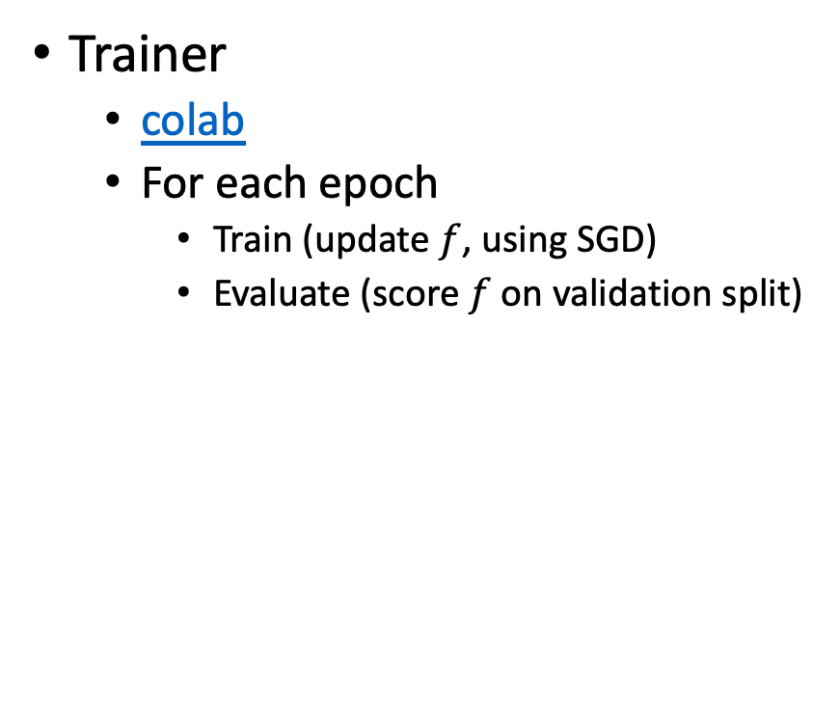
https://github.com/huggingface/transformers/blob/main/examples/pytorch/text-classification/run_glue.py
Trainer
colab
For each epoch
Train (update $f$, using SGD)
Evaluate (score $f$ on validation split)

Slide 50
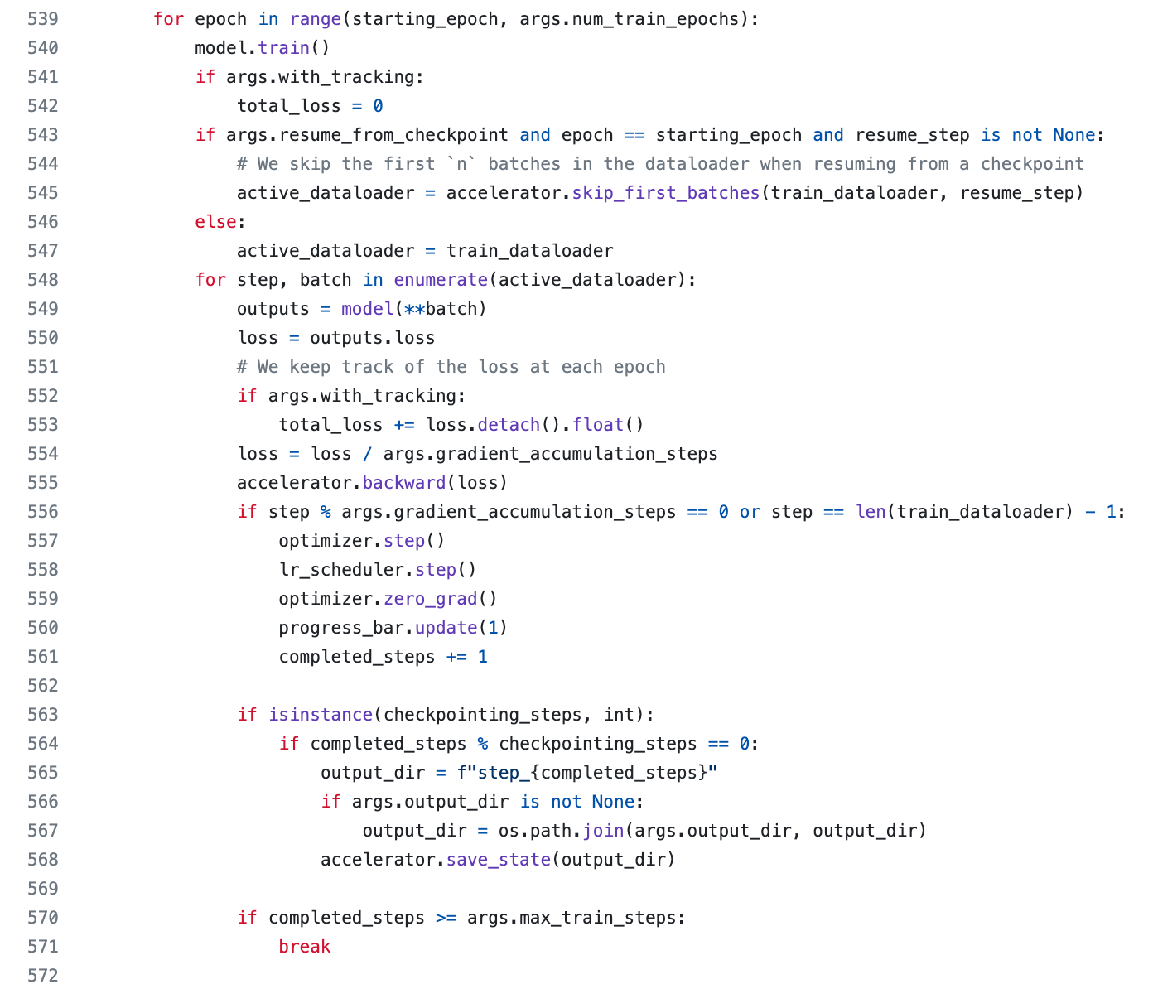
https://github.com/huggingface/transformers/blob/main/examples/pytorch/text-classification/run_glue_no_trainer.py
with trainer
649 lines of code
without trainer
665 lines of code
SGD is more obvious
in both cases,
the example is hardwired for GLUE
no clear distinction between
foreground:
GLUE-specific functionality
Names of tasks, loss, metric
background:
General purposefunctionality that applies to many/most classification problems

Slide 51

https://github.com/huggingface/transformers/blob/main/examples/pytorch/text-classification/run_glue_no_trainer.py

Slide 52
Little Languages: Conclusions

